Slide 1




Understanding the NJ Real Estate Market with Data Science
Jibreel Hameed
8/5/2025

Slide 2

Outline
Introduction
Executive Summary
Methodology
Results
Conclusion
Appendix

Slide 3
Introduction
Background
The current system (or lack thereof) for real estate agents to analyze their local and distance markets is inefficient and time consuming. To properly represent clients and meet their needs, an agent needs to spend many hours throughout the week tracking recent sales, inventory, home prices and conducting comparable sales analysis. With this information, an agent can thoroughly understand market dynamics, when, where and how a buyer should purchase a property or to sell a home. However, markets change on a weekly and monthly basis. This can be overwhelming for new and even established agents as New Jersey has 4-5 different private MLS services which organize and display their data with different methods. This inefficiency can lead to increased frustration and lack of understanding with one's job, increased inability to keep up with fast paced markets, decreased client satisfaction and loss of revenue (salary).
The goal of this project is intended to achieve multiple objectives:
Create a system which automatically collects, cleans and stores real estate data on a weekly basis for each accessible MLS
Understand the relationship between a property’s sales price and it’s physical and locational characteristics
Determine if a property will be sold based on sales price and physical and locational characteristics
Create a dashboard to display market statistics as well as provide the ability to conduct data/market analysis on a state and municipal level
Obtain a deeper knowledge of the real estate market to not only be more informed, but also be a better asset to buyer and seller clients alike

Slide 4
Executive Summary
Data Collection and Preparation: The project began with the collection of relevant datasets from publicly available sources as well as paid data sources. Data cleaning and preprocessing were performed to handle missing values, normalize data, and ensure data quality for analysis. Data transformations and feature engineering were also conducted to optimize the dataset for machine learning models.
Exploratory Data Analysis (EDA): A thorough exploratory analysis was performed using SQL, data visualization techniques and statistical methods to identify patterns, relationships, and outliers within the data. This phase helped inform the selection of appropriate modeling techniques and variables for the subsequent predictive modeling phase.
Modeling and Evaluation: Regression and classification techniques were applied to the data. The models were evaluated using cross-validation, and various performance metrics (such as accuracy, precision, recall, and F1-score) were used to assess their effectiveness. Hyperparameter tuning was also carried out to optimize model performance.
Result Interpretation and Recommendations: After developing and evaluating the models, the results were interpreted to draw conclusions about the data and the problem at hand. The analysis provided actionable insights that addressed the project's main objective. Key recommendations were derived from the findings, which were communicated effectively to stakeholders.

Slide 5
Executive Summary
Summary of Results:
The analysis provided valuable insights into the problem being studied. The key findings include:
Data Insights: The exploratory data analysis revealed significant trends and correlations between various features in the dataset, highlighting factors that most influenced the outcomes.
Model Performance: The predictive models demonstrated high accuracy and generalization, with the best regression model achieving and R2 Score of 96.8% and the classification model achieving 84% accuracy.
Actionable Insights: Based on the analysis, several actionable insights were identified, including the continuation of acquiring more data and conducting more feature engineering. These findings can be used to inform decision-making or guide future research in the domain.

Slide 6
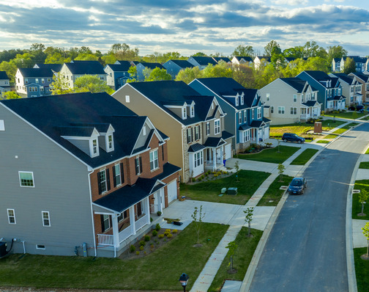
Section 1:
Methodology

Slide 7
Methodology
Executive Summary
Data collection methodology
Perform data wrangling
Perform exploratory data analysis (EDA) using visualization and SQL
Perform interactive visual analytics using Folium
Perform predictive analysis using classification and regression models

Slide 8
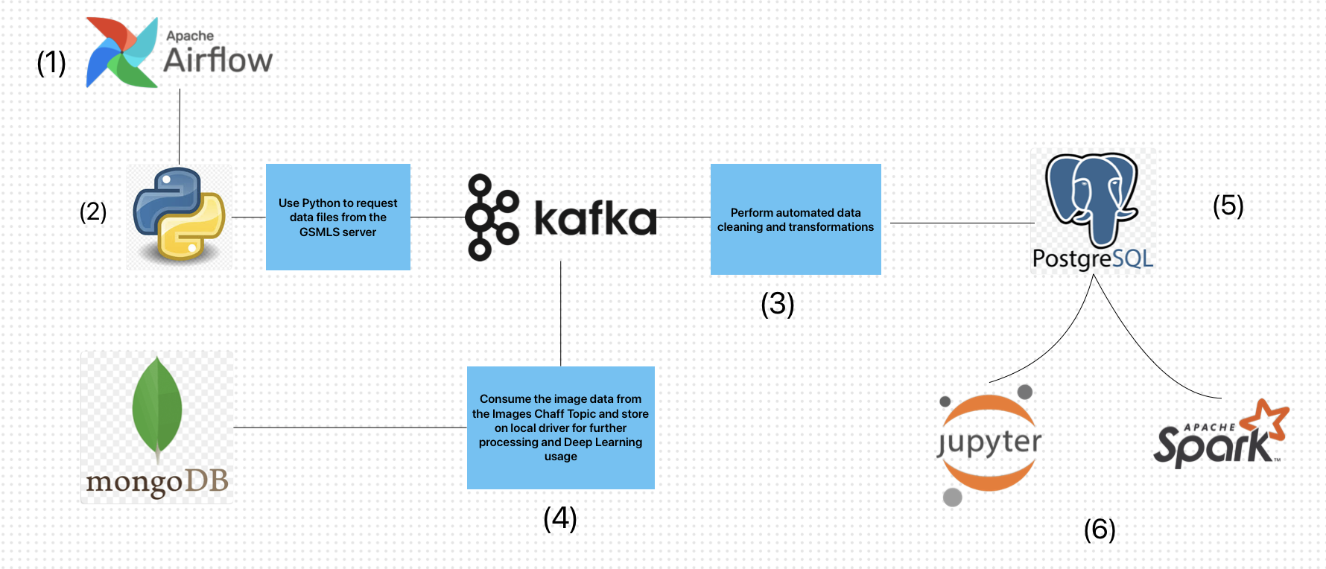
Data Collection
Pipeline Process:
Schedule data scrapes on a weekly basis
Use Python and Selenium to automate a script to send data requests from the GSMLS server and produce to Apache Kafka
Consume structured data from Apache Kafka to clean and transform
Consume image weblinks and residential property characteristics in MongoDB for later consumption
Store structured data in PostgreSQL
Use Jupyter Notebook for exploratory data analysis and further cleaning for Machine Learning
Apache Spark used for more efficient data merging/clean in specific processes

Slide 9
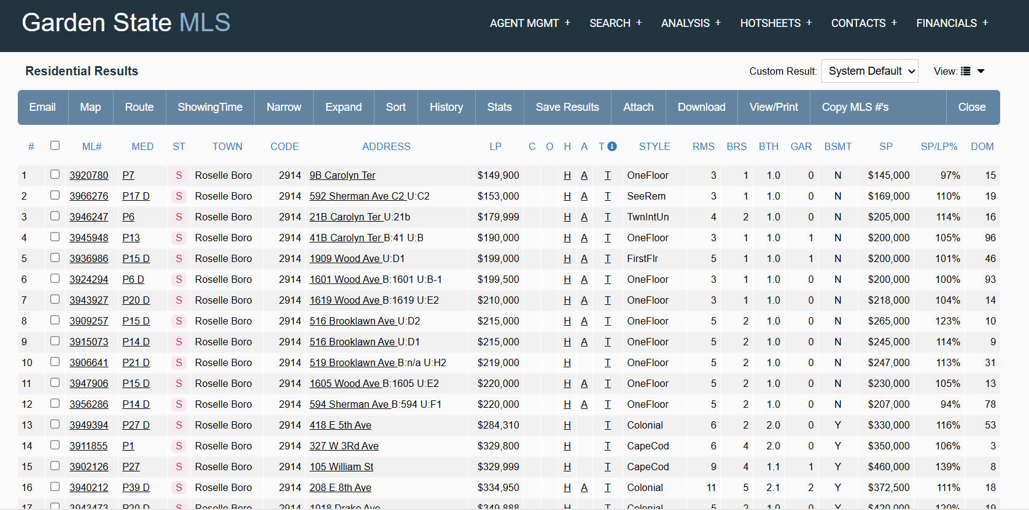
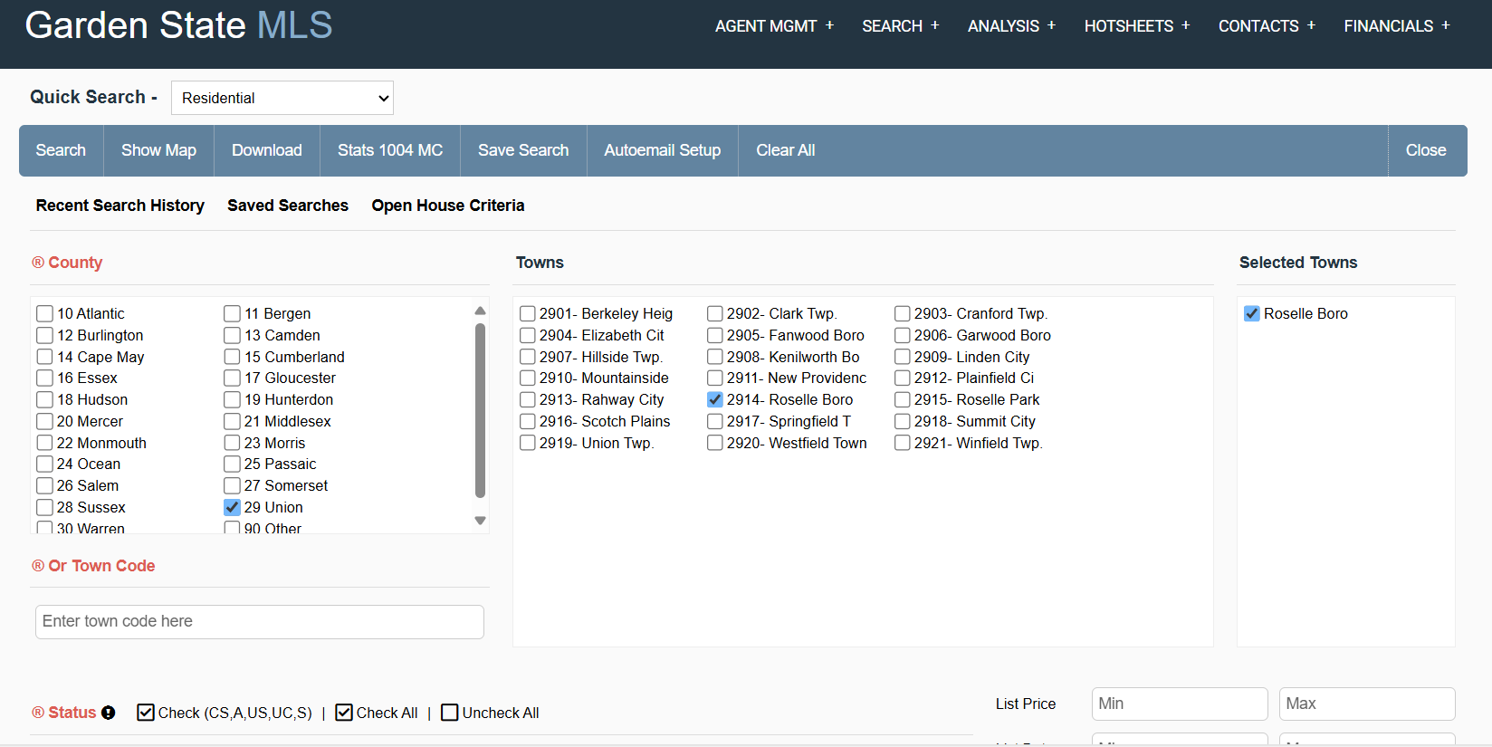
Data Collection – GSMLS
Created an automated script using Selenium to receive data in the form of xls/xlsx files
Files were then encoded as JSON and produced through Apache Kafka to await cleaning/wrangling
Produced data from 1996 - 2025
https://github.com/TheNJineer/GSMLS-Analysis/blob/main/GSMLS.py

Slide 10
Data Cleaning/Wrangling
Created an automated script which consumed data from Apache Kafka and cleaned the data
Cleaning process included
Removing unwanted characters from features
Correcting feature datatypes
Parsing column values to create new features
Used Regex on columns with string datatypes to identify key features about the property (bank owned, distressed/short sale, interior/exterior features)
Removing unwanted columns/features
Using tax data from a separate database to correct the livable square feet, lot size and year built features

Slide 11
Data Cleaning/Wrangling (cont’d)
Cleaning processes (cont’d)
Use Pandas to create aggregated data tables, per year per municipality to impute data for null and/or incorrect data
Use feature skews to understand which data needed transforming to resemble normal data distribution
Send associated images to NoSQL database
Data stored in PostgreSQL once cleaning is complete
https://github.com/TheNJineer/GSMLS-Analysis/blob/main/Kafka_GSMLSConsumer.py

Slide 12
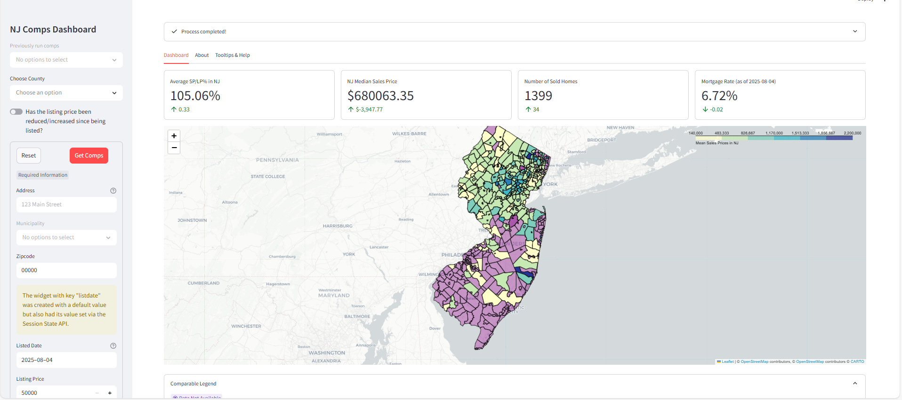
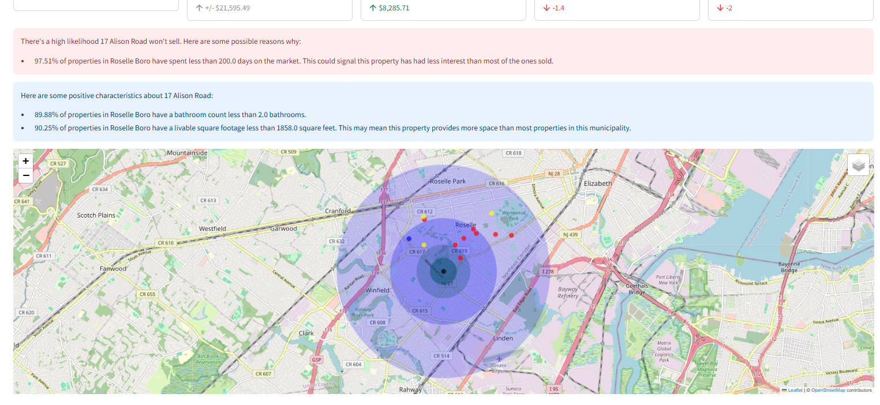
Build an Interactive Map with Folium
The dashboard uses Folium to display geospatial data on a state and local level
The State level view allows users to hover over municipalities to get real estate summaries on median sales price, average listing price percentage received, closed sales and mortgage rates
The local level view occurs when a user searches the comparable homes for their target property
https://github.com/TheNJineer/GSMLS-Analysis/blob/main/GSMLS_dashboard.py

Slide 13
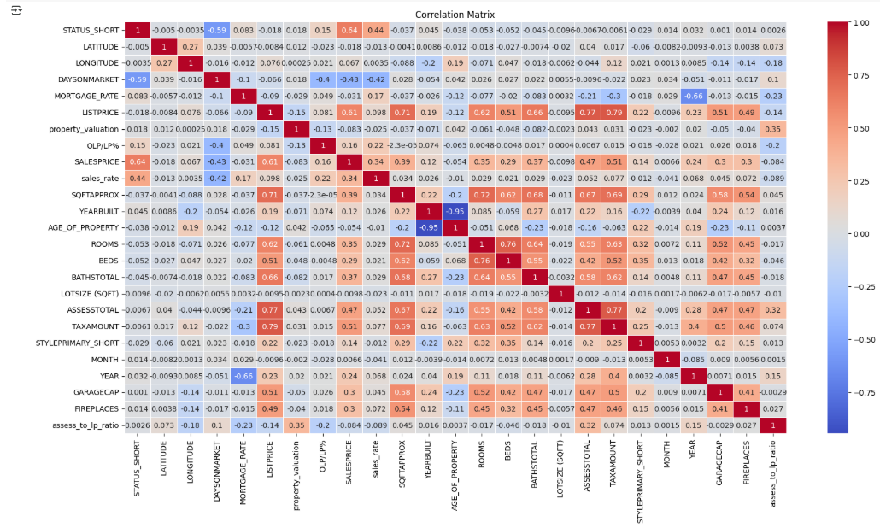
Linear Correlation Matrix
The correlation matrix shows how the features were linearly connected
The Status Short and Sales Price correlations were used as the baseline for minimum input nodes being fed into the neural networks output layers
Signification correlations (based on magnitude, not direction):
List Price – 0.61
Tax Amount – 0.51
Total Assessment – 0.47
Day on Market – 0.43
Livable Sqft – 0.39

Slide 14
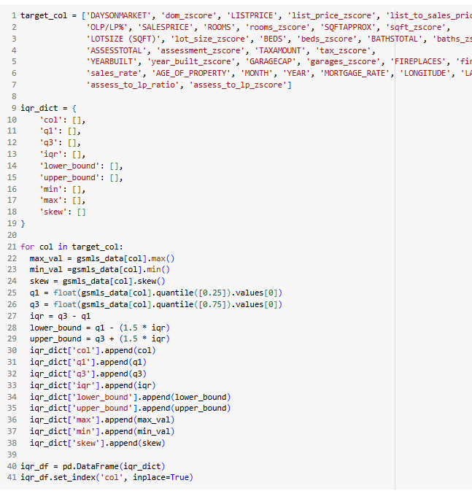
Predictive Analysis: Transformations
To prepare the data for machine learning training, I subjected the data to two stages of cleaning
Stage 1: Remove the obvious outliers
Obvious outliers were ones where I concluded the data couldn’t be imputed. An unexhausted list of examples could be if a house was sold and had less than 2 rooms total, was sold but the listing price was $0, property was sold but have zero bathrooms, or the property spent less than zero days on the market.
Stage 2: Create filters using descriptive statistics
Looped through the target features to determine the min and max as well as the 25th, 50th and 75th quartiles, respectively. I then standardized the data and filtered the data using the Z-scores so everything was on the same scale
To remove outliers but retain as much data as possible, I allowed data up to 5 standard deviations to be used (maximum Z-scores for some features ranged from 11 to 25. I’ve concluded this could either be incorrect data or data from mansions or unusually sold properties)

Slide 15
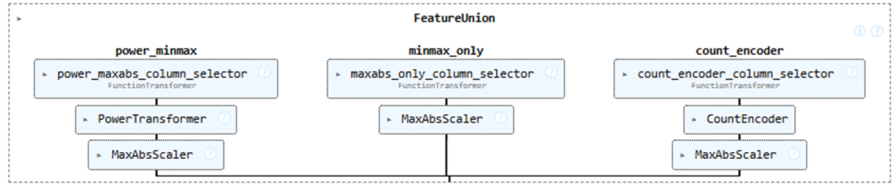
Predictive Analysis: Transformations (cont’d)
After the data was filtered, the feature skews were recorded to determine if transformations were necessary to resemble normally distributed data
The data also needed to be standardized, and string features encoded to numerical values
The following transformations were used:
Yeo-Johnson Power Transformation - fix skewed data
Min-Max Absolute Scaling – standardization technique
Count Encoder – Assign a numerical value to a string value based on frequency of occurrence
A custom data transformer had to be constructed using Sci-kit Learn Feature Union to ensure the correct transformations were applied to the correct columns

Slide 16
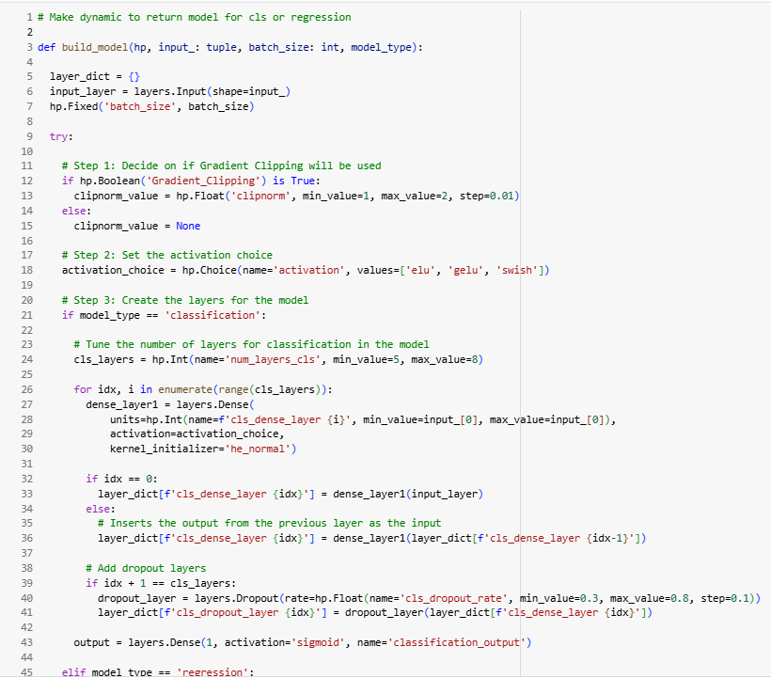
Predictive Analysis: Model Training
Before training both classification and regression models, I needed a method to determine the best combination of hyperparameters to use for each model
TensorFlow Keras doesn’t have a native Grid Search CV function, but the closest thing to it the Keras Tuner object
Keras Tuner is less exhaustive than Grid Search but it can provide a starting point for good hyperparameters

Slide 17
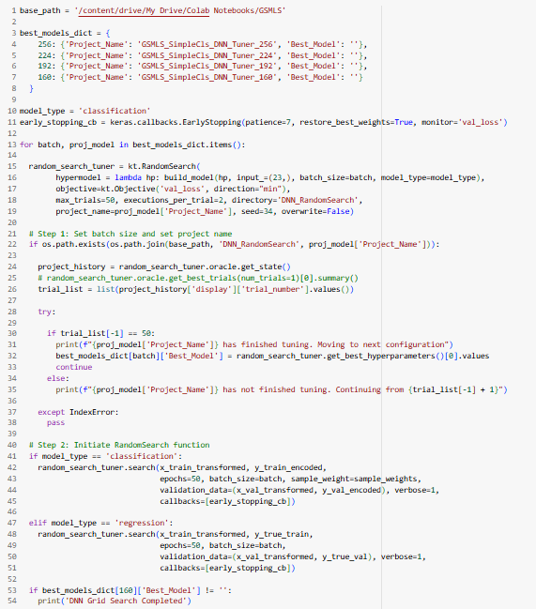
Predictive Analysis: Model Training (cont’d)
An iterative hyperparameter training was created to loop over multiple batch sizes and trials
This training loop will continue to be utilized as new data is acquired and added to the dataset
https://github.com/TheNJineer/GSMLS-Analysis/blob/main/GSMLS_DNN_Training.py

Slide 18
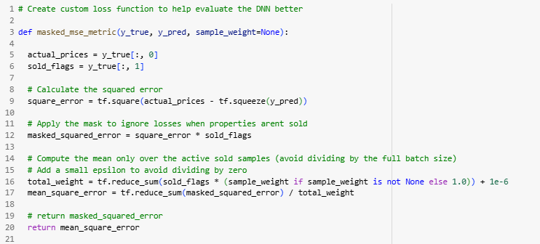
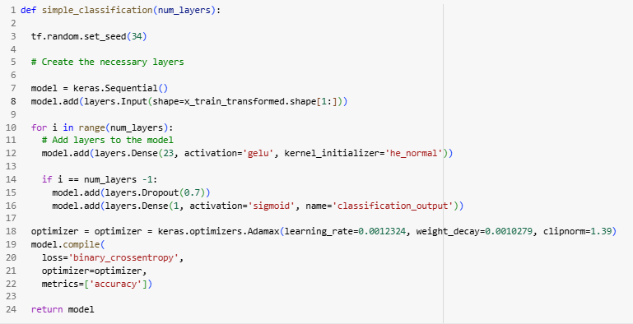
Predictive Analysis: Model Training (cont’d)
Created a custom evaluation metric for the regression model
Because the data contained homes that were both sold and expired on market, the expired homes had sales prices of $0. This negatively skewed the target data range and therefore the mean squared error metric
The custom evaluator filtered out the expired homes and only focused on the ones which sold
Created functions which dynamically built the neural network architecture to speed up the training process
https://github.com/TheNJineer/GSMLS-Analysis/blob/main/GSMLS_DNN_Training.py

Slide 19

Section 2:
Insights Drawn from EDA (SQL Queries and Data Visualization)

Slide 20
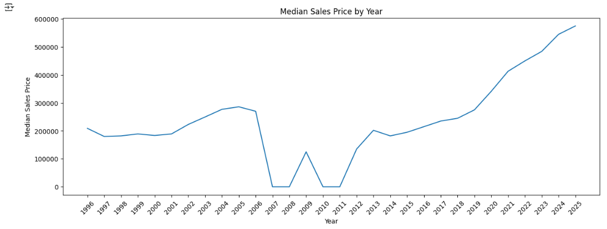
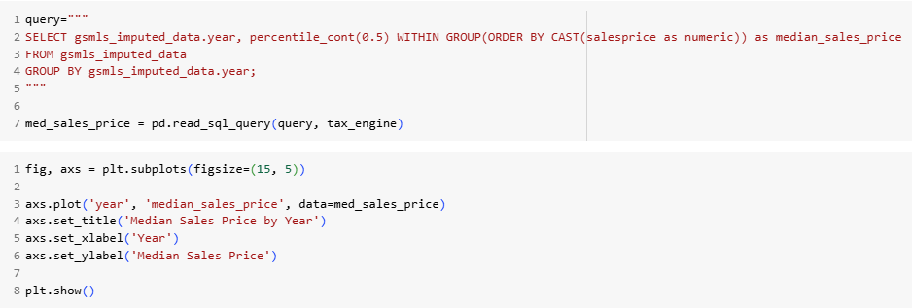
Median Sales Price by Year
The median sales price of homes in New Jersey has steadily increased after the Great Financial Crisis
*This plot was created using filtered data trained on by machine learning algorithms, therefore certain data can be missing

Slide 21
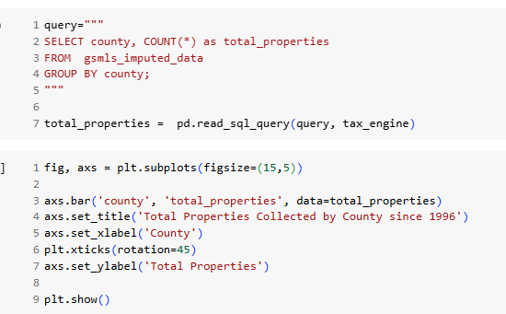
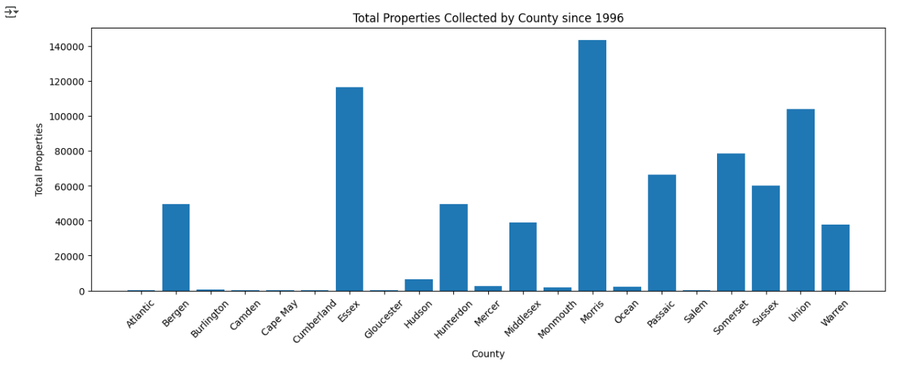
Most/Least Transactions Collected by County
Before commencing this project, it was understood that this MLS service covered a large area of NJ but some counties reported to separate/regional MLS
The bar chart shows that since data was first collected, most of the data received are from counties located in Northern and Central New Jersey
Morris, Essex and Union counties have reported the most residential real estate transactions respectively since 1996

Slide 22
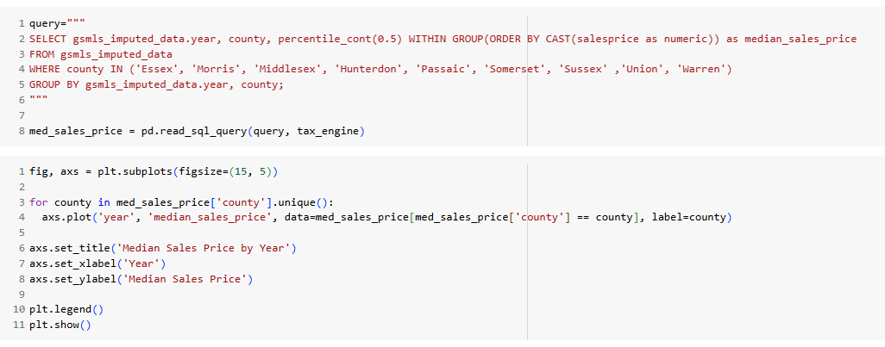
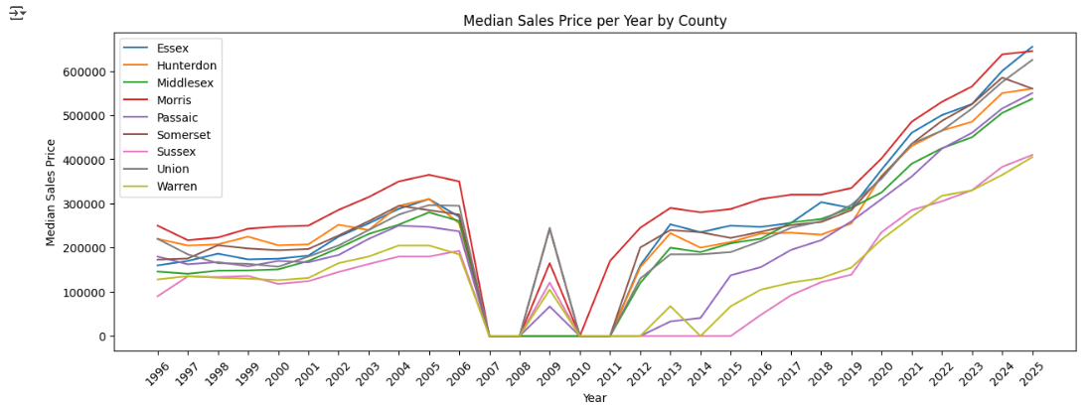
Median Sales Price by Year By County
Of the counties with sufficiently reported data in this MLS, the Top 3 counties with the highest median sales price are Essex, Morris and Union, respectively. Somerset County seems to be the only county to have decreased YoY in 2025. However, this will be revisited once we have a full year of sales data
*This plot was created using filtered data trained on by machine learning algorithms, therefore certain data can be missing

Slide 23
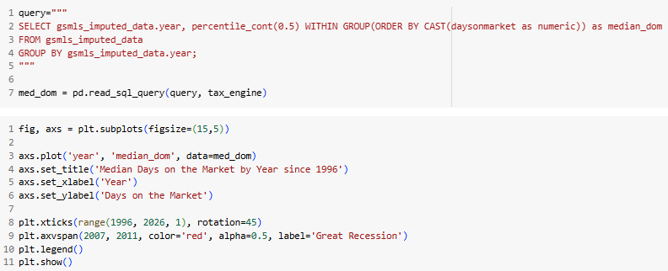
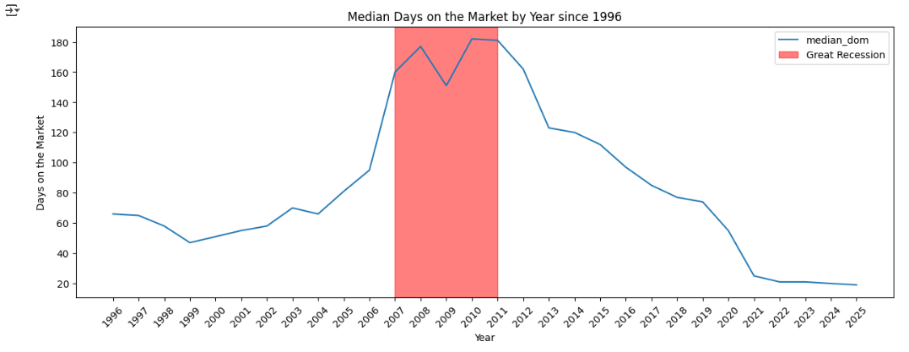
Median Days on the Market by Year
Properties in New Jersey spent the most time on the market during the Great Financial Crisis with the peak median Days on Market (DOM) occurring in 2008 and 2010
Since 2011, a property’s time on market before being sold has steadily decreased
After COVID in 2020, the median DOM for properties sold in NJ has not gone above 30 days

Slide 24
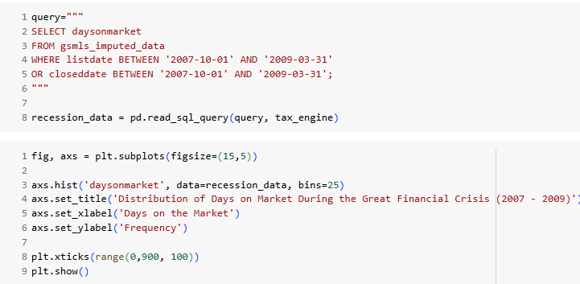
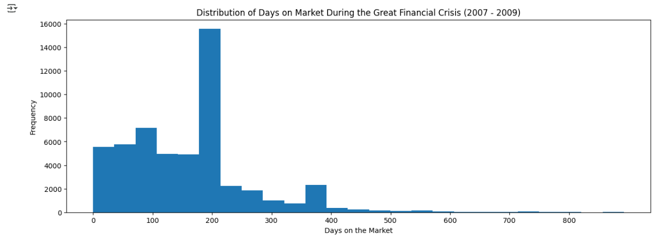
Days on the Market Distribution (Great Financial Crisis)
Continuing to focus on the period of the Great Financial Crisis, the graph below shows the distribution of DOM for properties sold or expiring
The data is right skewed with some properties spending a year or more on the market before being sold or expiring
The most frequent occurrence was around 200 days

Slide 25
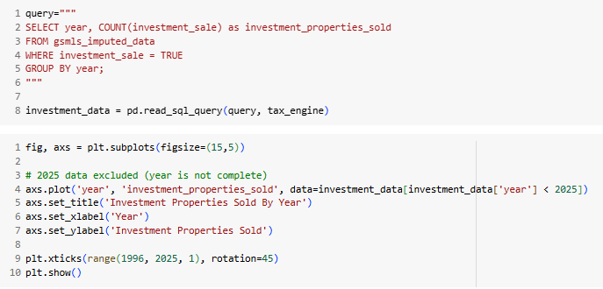
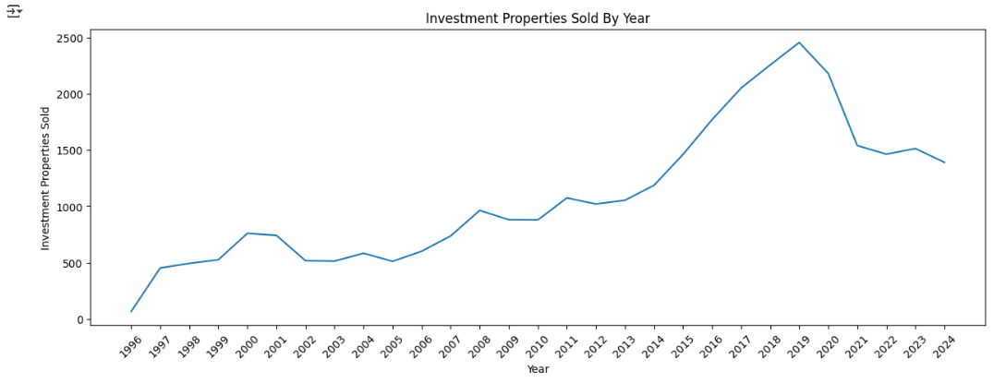
Investment Properties Sold By Year
As a real estate agent and an investor, I’m extremely interested in the amount of investing going on in the state
The graph below show properties sold by a company for each year starting in 1996
Based on the data in this MLS, I’m unable to capture the name of the person/entity who purchases the property; only who sells it.
The entity was determined using Regex to match a pattern like LLC, Corporation, Management, etc
Investment sales peaked in 2019 with almost 2500 homes being sold by corporations, but has since declines
This peak occurs right before COVID and median sales prices exploding

Slide 26
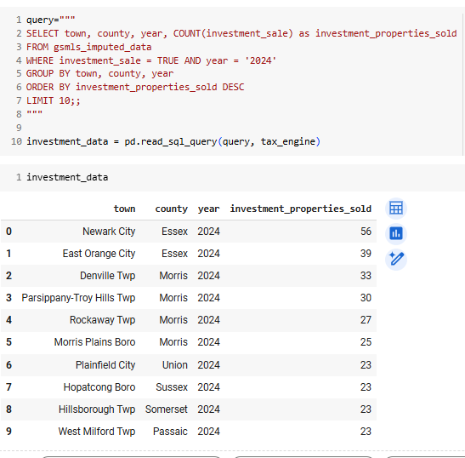
Top Ten Municipalities for Investing in 2024 (Based on Investment Sales)
The data shown here are the Top Ten Municipalities for Investing in 2024 (Based on Investment Sales)
Six of the ten municipalities have a major NJ Transit line and multiple bus routes
Through anecdotal research, these municipalities have been shown to be major destinations for residents migrating from NYC

Slide 27
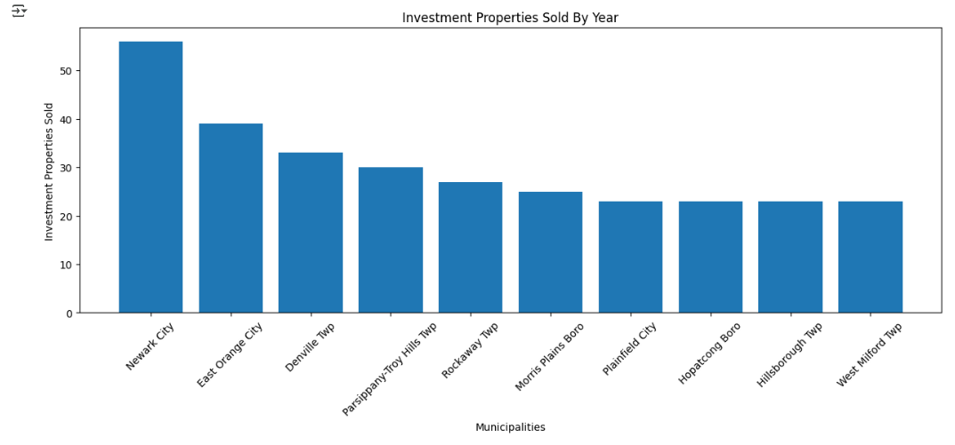
Top Ten Municipalities for Investing in 2024 (cont’d)

Slide 28
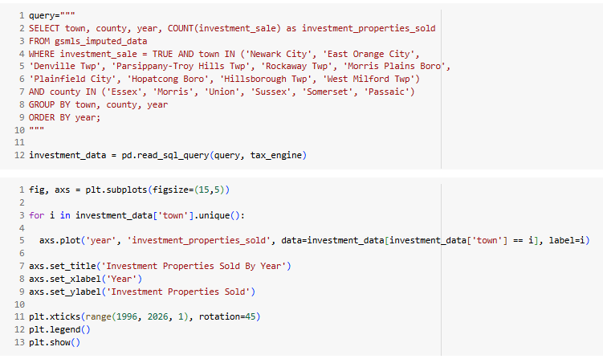
Top Ten Municipalities for Investing by Year (Based on Investment Sales)

Slide 29
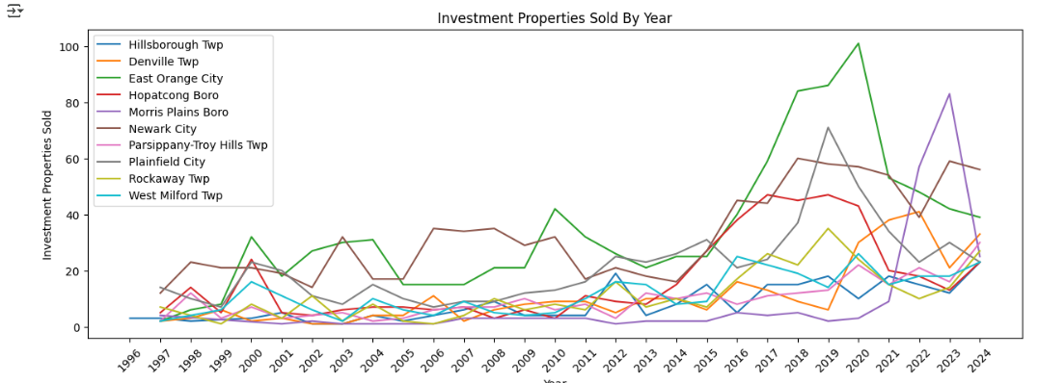
Top Ten Municipalities for Investing by Year (Based on Investment Sales)
Most of the Top Ten Municipalities has their investment sales peaks between 2017 – 2020 with East Orange have the highest peak of them all in 2020
Morris Plains had a later period of heavy investing occurring from 2021 and peaking in 2023
The city of Newark has had two peak investment period occurring in 2018 and 2023 respectively

Slide 30
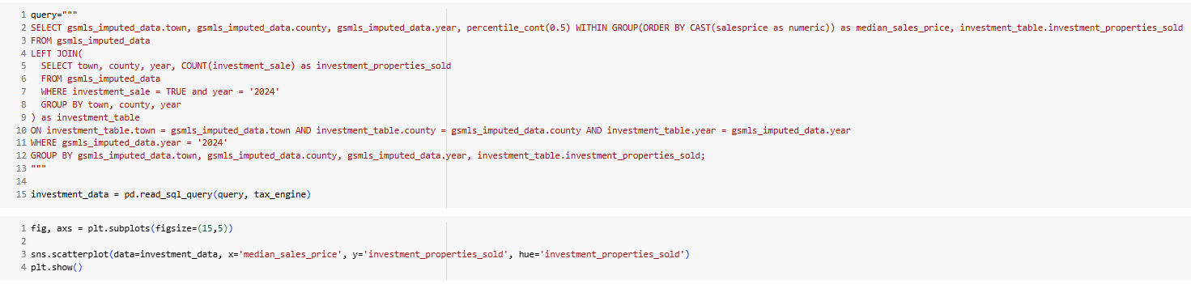
Investment Properties Sold vs Municipal Median Sales Price (2024)

Slide 31
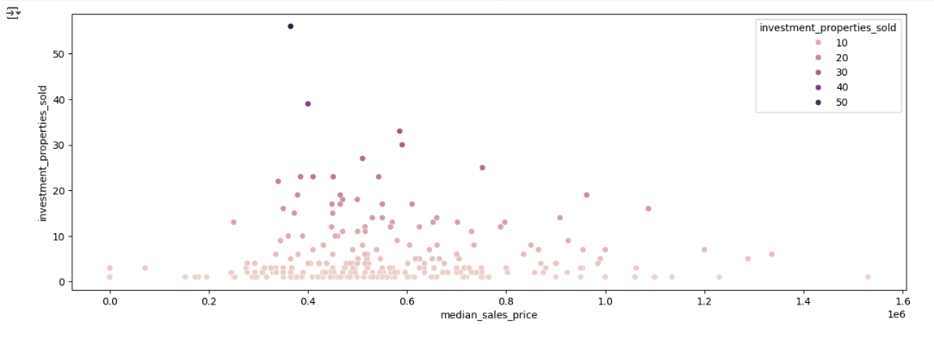
Investment Properties Sold vs Municipal Median Sales Price (2024)
I wanted to see what the distribution was like for total investments in municipalities across the full range of median sales prices (Is investing targeted to primarily to lower prices areas?)
It seems like investing is concentrated in municipalities with median sales prices ranging from approximately $300k to $800k
This range is a lot higher than my assumed range of approximately $200k to $500k

Slide 32
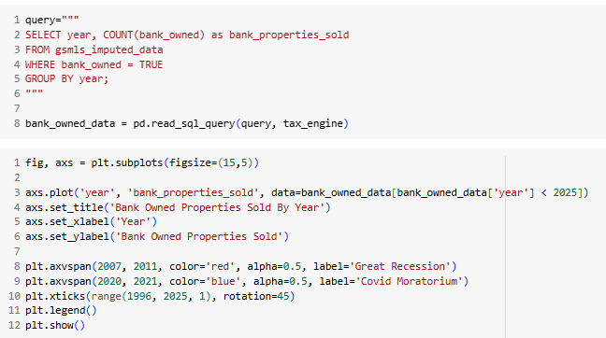
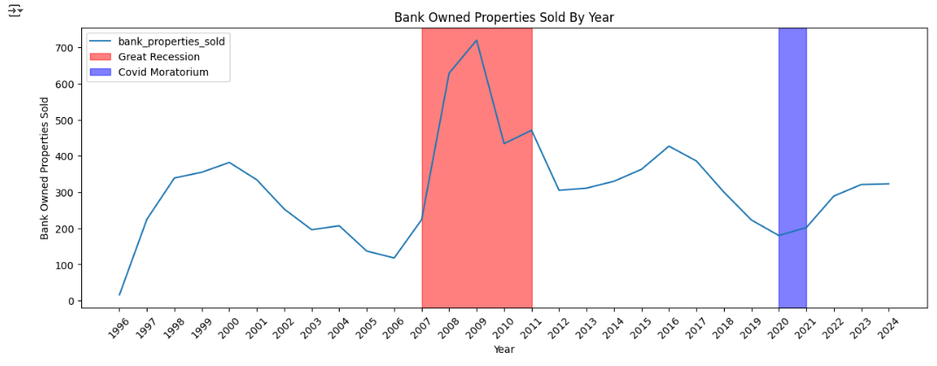
Bank Owned Properties By Year
The graph below shows different periods of the real estate market where foreclosures were on the rise
As expected, the highest rise and peak of properties foreclosed and sold by the bank occurred during the Great Financial Crisis
Highlighted in blue was the period of COVID where unemployment was at it’s highest. However, a national mortgage moratorium was passed where homes could not be seized due to late/delinquent mortgage payments
Bank foreclosures have steadily been on the rise and have plateaued from 2023-2024

Slide 33
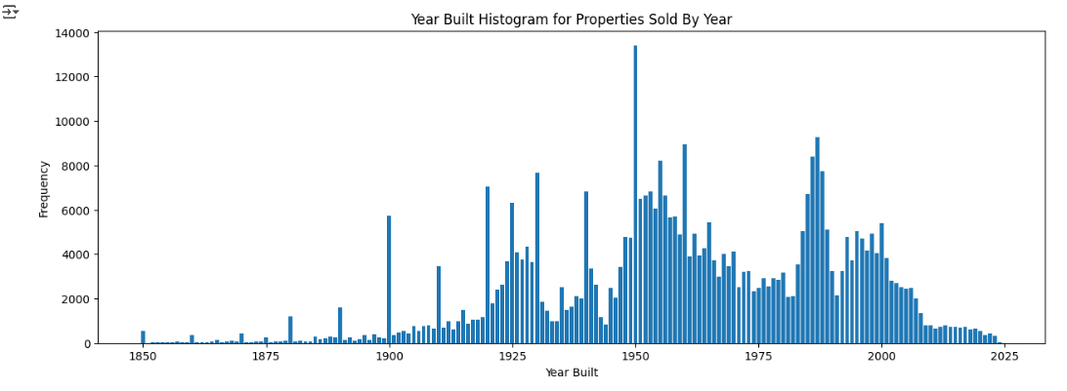
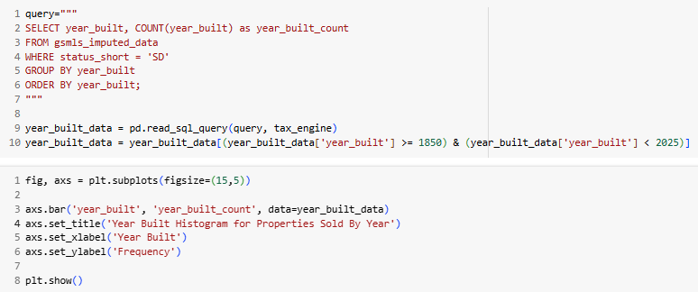
Distribution of Homes Sold by the Year Built
Homes built in the 1950s and 1980s dominate the existing sold market
New construction Single family homes have seen a heavy decline since the early 2000s
Possible factors for the decline:
Lack of available land to develop
Lengthy process in which new construction projects need to be approved
Rise in the cost of materials
New construction and existing homes have become less affordable

Slide 34
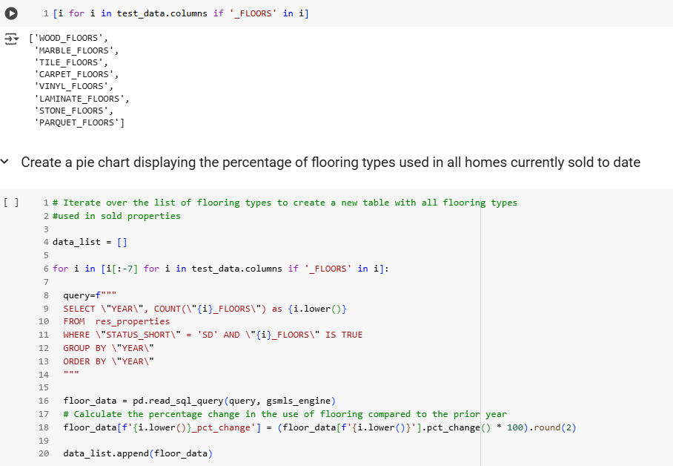
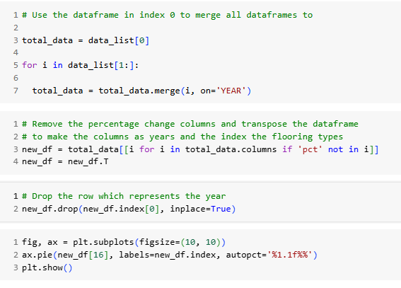
Types of Flooring Observed in Homes Sold (2024)

Slide 35
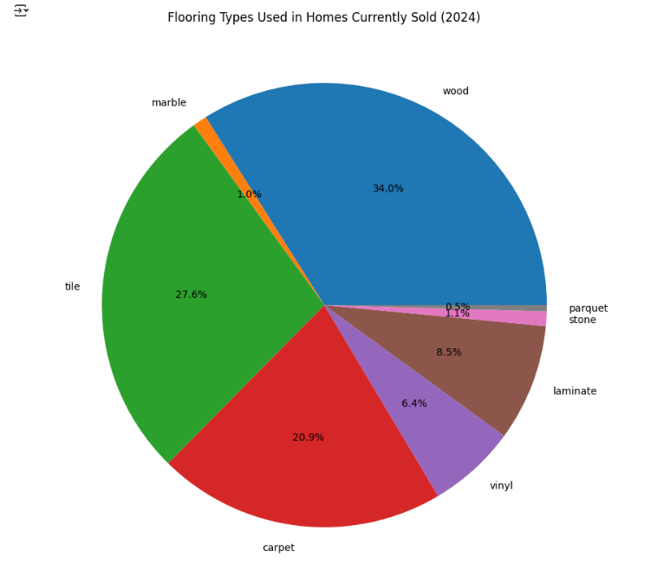
Types of Flooring Observed in Homes Sold (2024) cont’d
Types of flooring used in a property can add value, especially if one is considering selling in the future
The most common floor types are wood, tile and carpet, respectively, with most properties having at least two of the three present
Parquet, marble and stone are the least common flooring types. These flooring types are found in higher priced properties

Slide 36
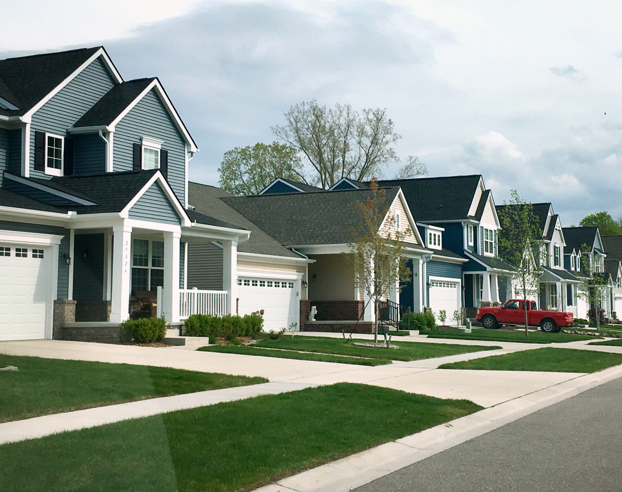
Section 3:
Data Visualization (Folium Dashboard)

Slide 37
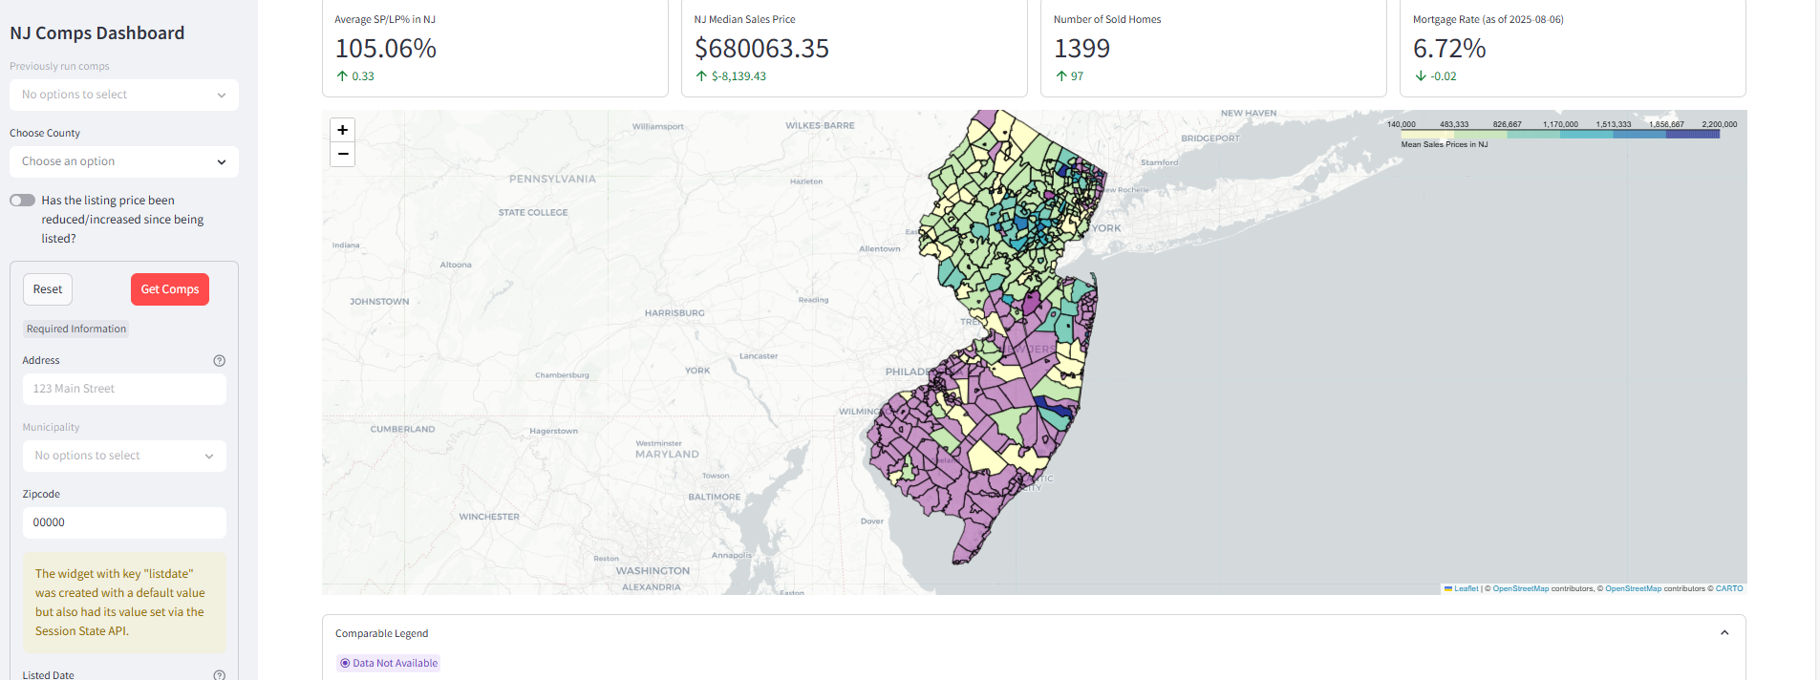
NJ Comparables Dashboard
The NJ Comparables Dashboard was designed to be a one-stop shop for real estate agents, home buyers and home sellers alike in the state of NJ to generate quick comparable properties as well as gauge a subject property's sales price based on its physical and locational characteristics.
In addition, one can assess local real estate market activity with closed homes (metrics such as homes available, currently under contract, withdrawn/expired coming soon) to help recognize what transactions are occurring on a weekly basis.

Slide 38
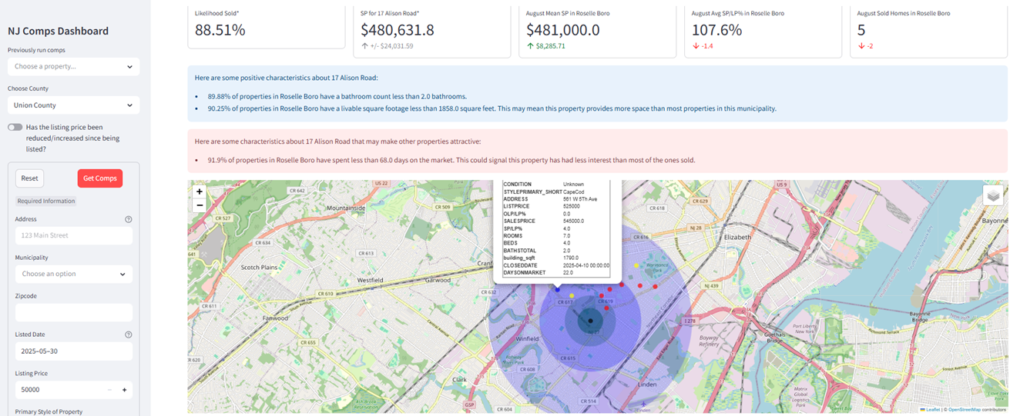
Comparables Results
This screen shows the comparable results to the target house
The larger blue circles on the map depict the radius from the target property in which a comp would be considered (0.25 – 2 miles)
The quality of the comps are color coded to show which ones should be shown the most focus with blue meaning the best comp and red being not-so significant (legend appears on the dashboard)
A regression deep neural network is deployed to help predict the price which the target property can sell with a +/- 5.1% average MOE
The dashboard provides interesting statistical information about the target property’s intrinsic characteristics if they stand out against the population

Slide 39

Section 5:
Predictive Analysis
(Classification & Regression)

Slide 40
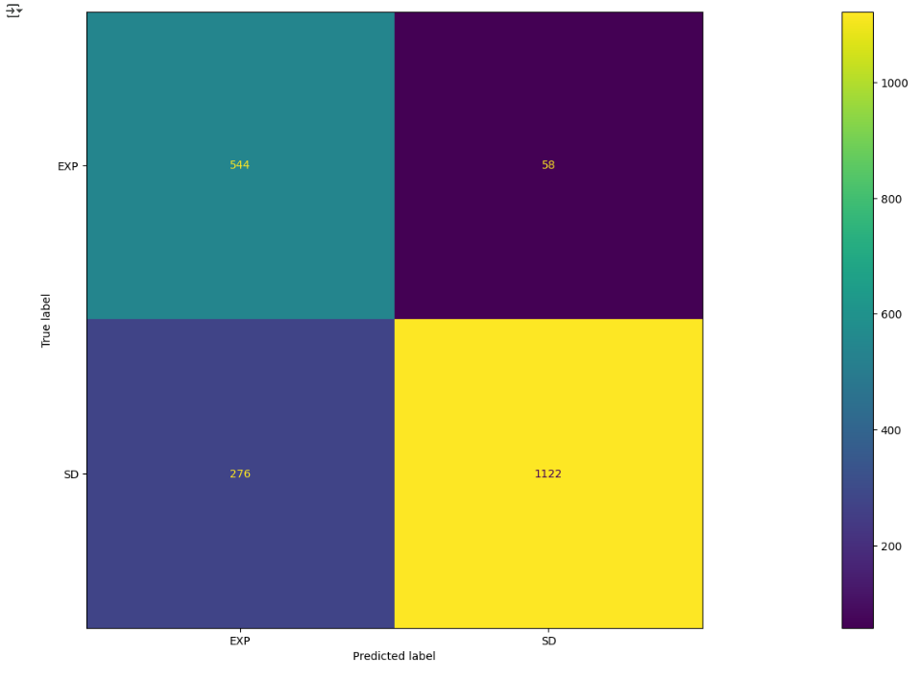
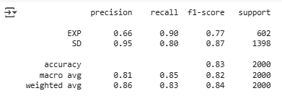
Classification Accuracy & Confusion Matrix
The classification model seems to perform well for predicting ‘Sold’ homes, but needs some improvement for determining when a home will expire on market
Recall for true ‘EXP’ labeled instances are very good
The dataset is heavily weighted towards homes sold; retraining with balanced training data will be necessary

Slide 41
Regression Model Evaluation
Metrics | Benchmark | Model Results
Median Sales Price | --- | $600,000
R2 Score | 0.95 or greater | 0.968
Mean Absolute Error (MAE) | A value between 5-10% of the median target value is considered good | $ 39,434.81
Root Mean Squared Error (Normalized RMSE) ⁽¹⁾ | A value between 5-10% of the median target value is considered good Range: 0 – 1. Values closure to 0 represents a better model | $70,555.21 (0.17)
Mean Absolute Percentage Error (MAPE) ⁽²⁾ | A value between 5-20% of the median target value is considered good | 5.27%
Coefficient of determination meet the criteria for a good predictor. This metric will be monitored as new data is acquired
The MAE and RMSE are 6.57% and 11.76% of the median target value, respectively. The MAE meets the benchmark criteria, however, the RMSE still shows outliers still present an issue.
The MAPE meets the benchmark criteria and shows that the model can be relied upon for its predictions

Slide 42
Conclusions
The regression DNN captures the 96.8% of the sales price variance from the available data
The classification DNN has an F1 Score of 85%
More training data needs to be acquired to improve both models, but especially for the classification. There are still some features needed to help distinguish between a property which is sold/not sold
Collected data is concentrated in the Northen and Central municipalities. Access to data for South Jersey is necessary for better model generalization and improvement
Home prices continue to rise YoY while total numbers of home sales continue to decline
The median days a property spend on the market before being sold hasn’t been above 30 days since 2021. This signifies heavy buyer demand for homes.
Bank foreclosures have steadily increased since the COVID mortgage moratorium ended in 2021 but has plateaued in 2023 - 2024
Properties bought by investors in NJ peaked in 2019 and have declined since
Homes built in the 1950s and 1980s dominate the existing homes market. There has been a lack of new construction homes built since the early 2000s

Slide 43
Next Steps
Train a multi-classification CNN to label real estate images for the property’s quality/condition and the area/section of the house
Change the “Unknown” value of a property’s “Condition” to the predicted classification label
Retrain the classification network now using “Condition” as a feature
Use sentiment analysis on a property’s listing remarks also understand the condition of the house
Do an analysis of the results of the visual prediction vs the sentiment prediction. Which one more accurately depicts the quality of the house? Can I use the sentiment prediction as a regularization (of some sort) for the image quality prediction?
Create dashboard to monitor the results of the neural networks and keep track of each iteration and change log of the retraining/updates

Slide 44
Appendix
(1) https://www.statology.org/what-is-a-good-rmse/
(2) https://www.statology.org/how-to-interpret-mape/

Slide 45

Thank You

